Slide 1
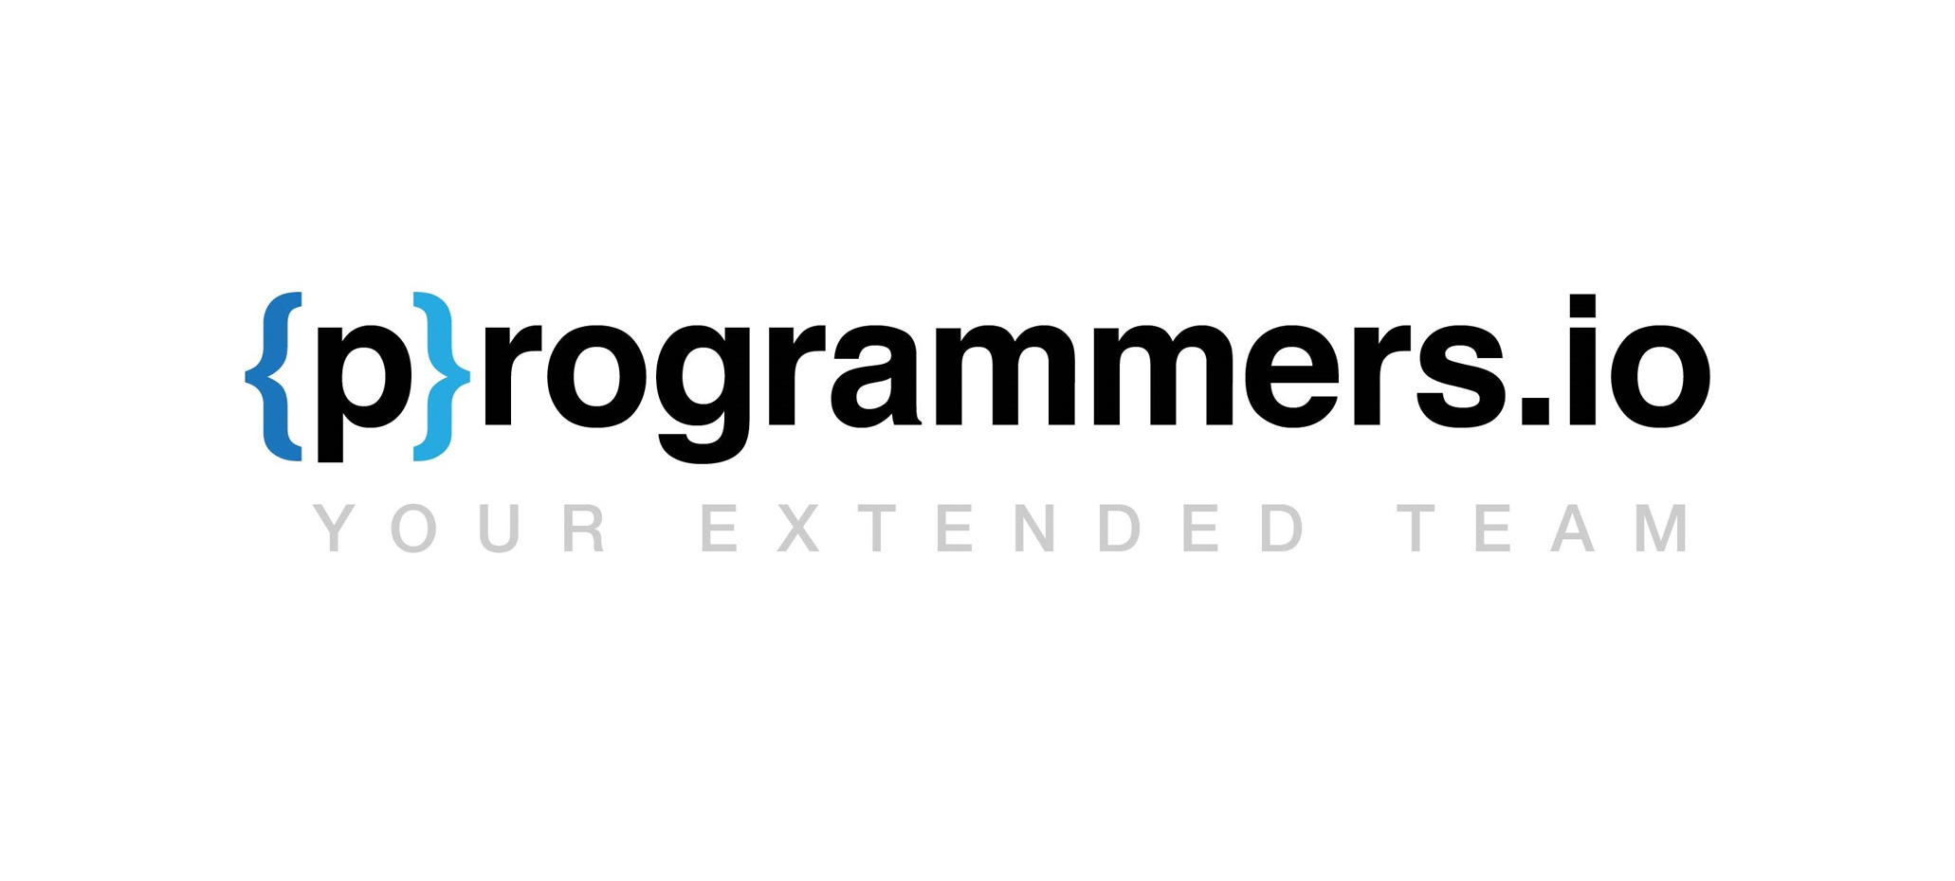
A Modern Approach to take the Development on IBMi to the next level
DevOps on IBMi

Slide 2


Topics covered
The what and why of DevOps?
Integral Parts of DevOps
Git it done!
Flavours of Git
GitHub
Jenkins
A Modern workflow for IBMi Developer
Conclusion
Programmers.io Confidential and Proprietary

Slide 3

What is DevOps?
DevOps is a set of practices that provides integration between software development (Dev) and IT operations (Ops).
Improve the speed and quality of agile software development.
Easy collaboration with cross platform teams.
Automation is the core of DevOps.
Why is it required?
Future proof your existing Tech Stack.
Easier to find younger talent.
DevOps is the IBMi Modernization that we all needed.
Programmers.io Confidential and Proprietary

Slide 4

Integral Parts of DevOps
Source Control Management / Version Control System
E.g., GIT, SVN
CI/CD Pipeline
E.g., Jenkins, GitLab CI/CD
Project Management
JIRA, GitHub, Azure DevOps
Modern IDE
VS Code, RDi
Programmers.io Confidential and Proprietary

Slide 5
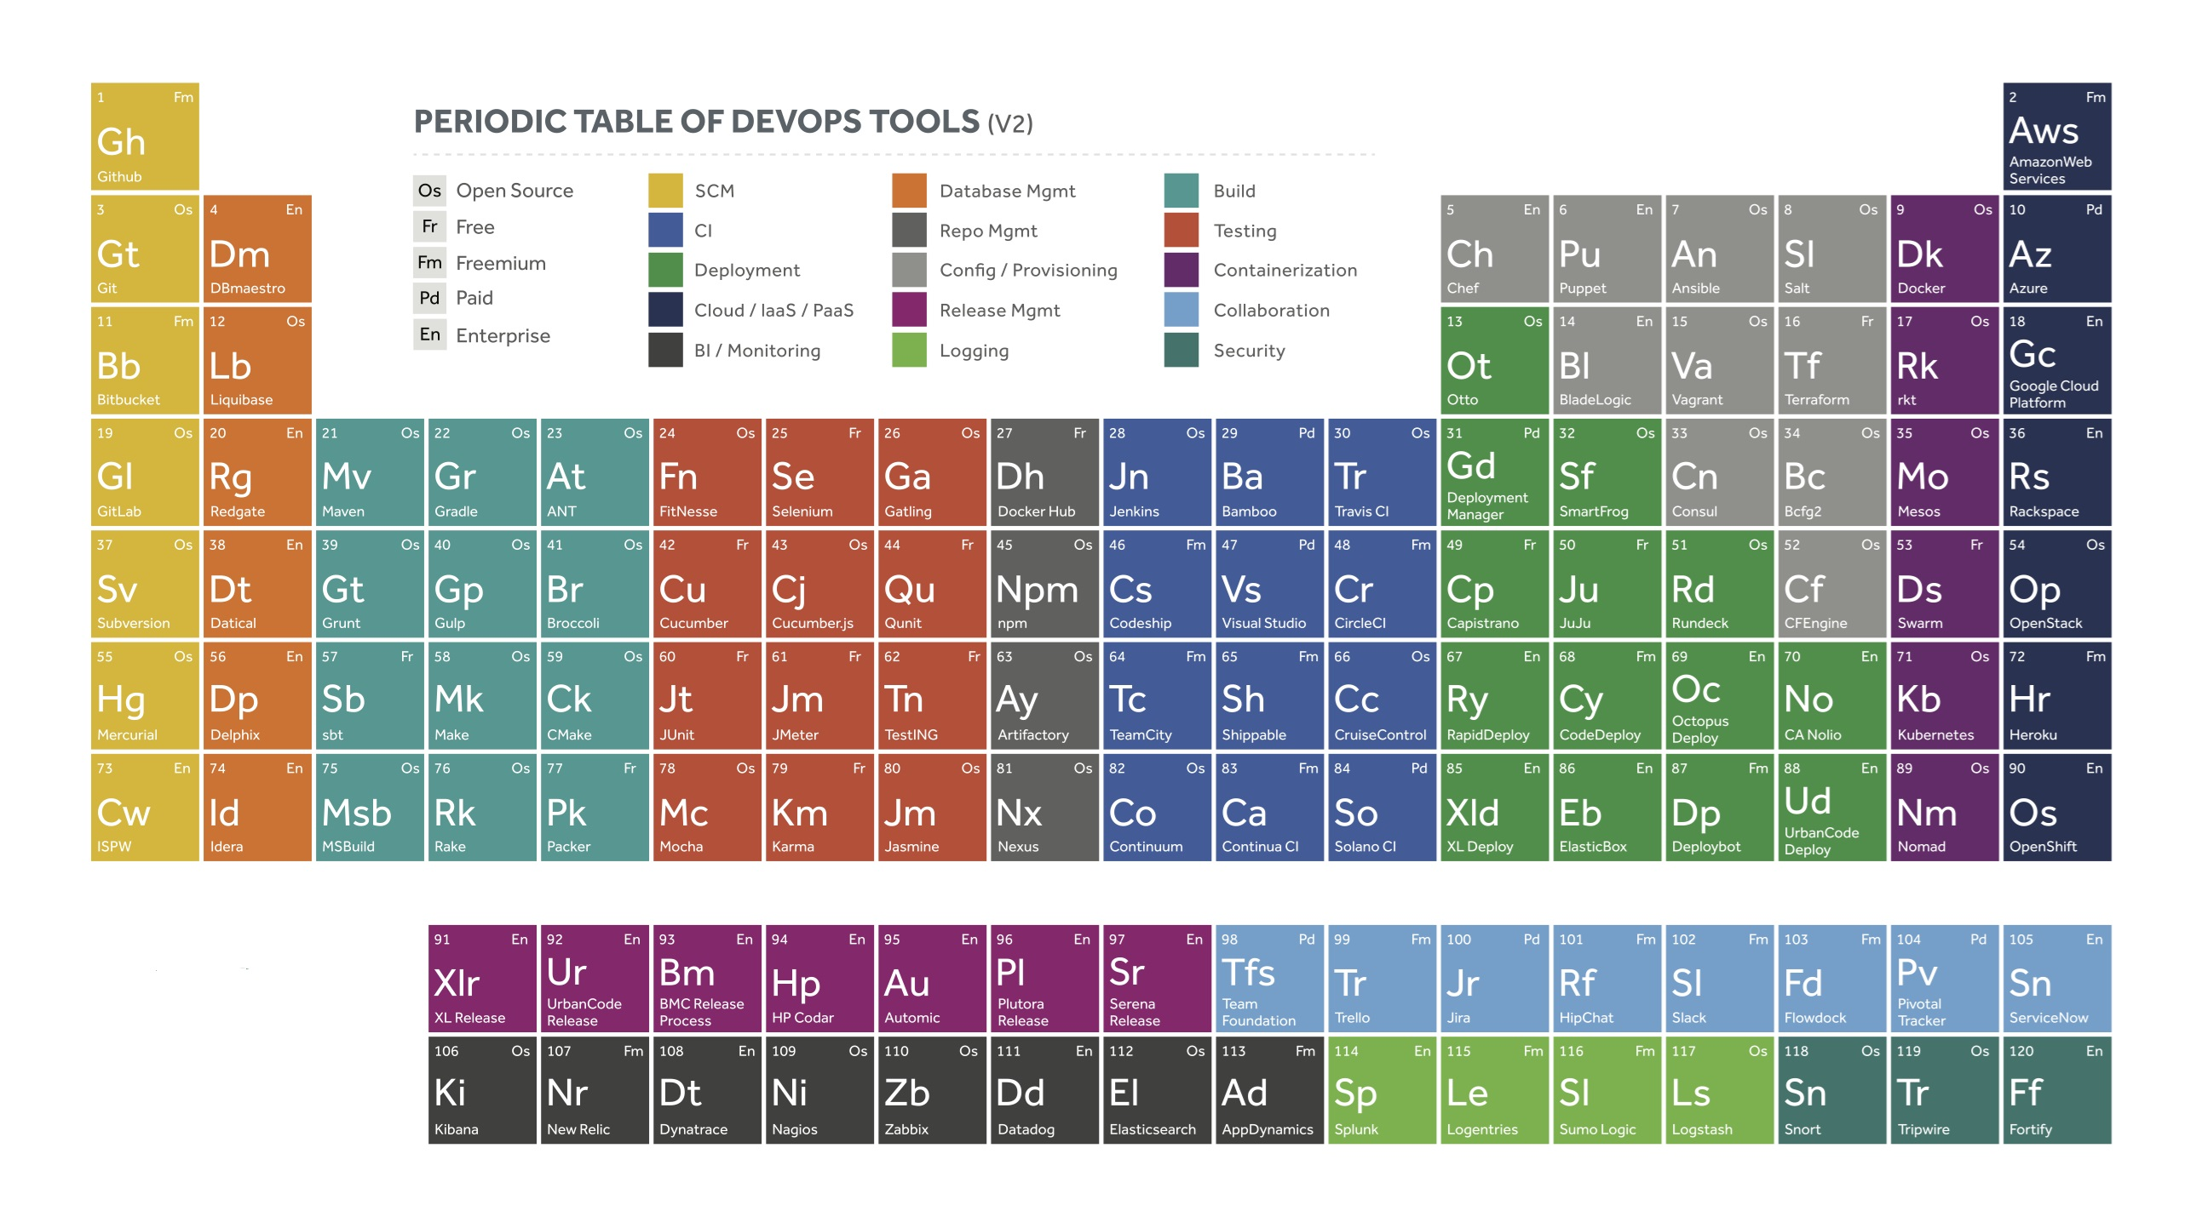
Wait, is that all we got?
Some of the tools available in the DevOps arsenal
Programmers.io Confidential and Proprietary

Slide 6

GIT-ting ahead in Development
Let’s talk about GIT:
It is the big daddy of Version Control System. Like any other VCS, it is used to keep track of the changes to your source code.
But wait…
We have Turnover, Implementor, Aldon , etc., already!
Well, GIT
is 100% free and open source
is a distributed VCS
empowers parallel development
enables historical comparison
is snapshot based.
enables local operations.
enables powerful integration
Programmers.io Confidential and Proprietary

Slide 7

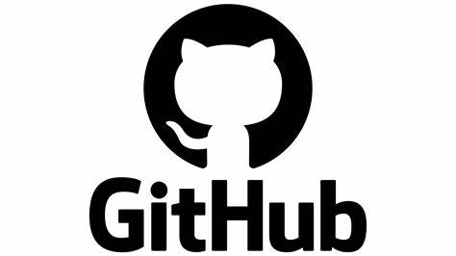
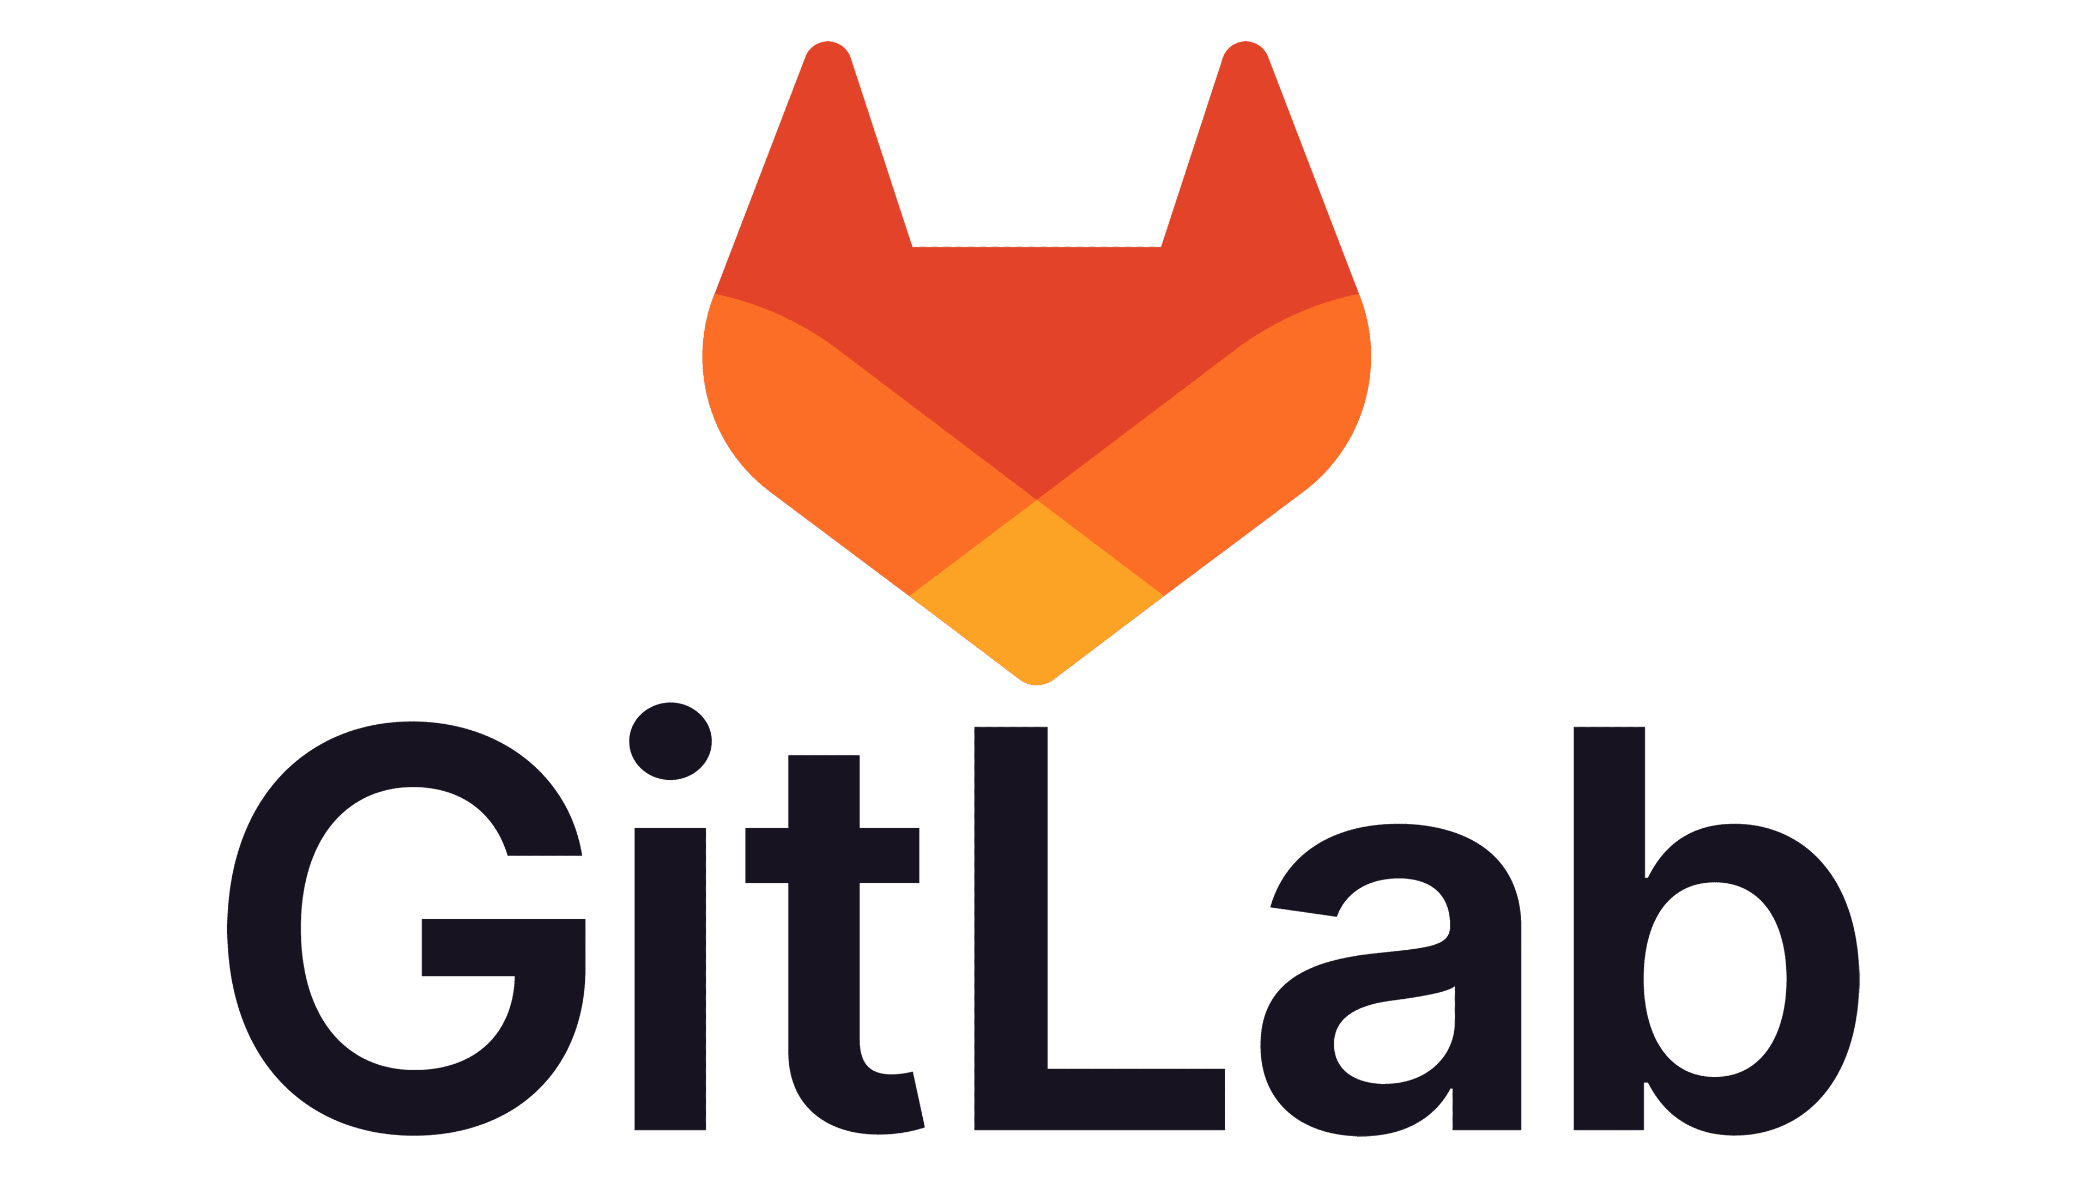

Choose your GIT flavour
GitHub:
Proprietary and Cloud Based
Owned by Microsoft
Most popular
BitBucket:
Proprietary and Cloud Based
Owned by Atlassian
Can be integrated with Jira
GitLab:
Open Source Alternative to GitHub
Has CI/CD pipeline Built-in
Can be installed on any Server, except IBMi
GitBucket:
Open Source and Can be installed On Prem.
Installation & Maintenance are on us.
Can be installed on IBMi and thus provide more privacy to the source code.
Programmers.io Confidential and Proprietary

Slide 8
GitHub – A GIT with Wings!
GitHub:
World’s largest Source Code Hosting Platform.
Has Project Management Tool built in.
It helps to create excellent documentation.
Collaboration and real-time updates
Project Boards
Third Party Integration
Programmers.io Confidential and Proprietary

Slide 9
Don’t ‘commit’ to trouble: Git Concerns for IBMi Developers
If you use GIT, know that
Each developer will have a minimum of 1 copy of the dev repository.
Since Git is consider every source as plain text file. It is required to Maintain the sources in IFS.
You need to know how to compile from IFS. There are paid tools like iForGit that bridges the gap b/w IFS and Traditional Source Files. But it is a good skill to have.
You will lose the ability to color code comments. But it is for greater good.
Some source audit information will be lost, such as “info about compiled from which source physical file”
Git and GitHub are different applications. Git is mostly used by Developers, while GitHub is widely used by Project Managers and Team Leads.
It can only manage the source code and it cannot compile, find dependent objects, test the code, do impact analysis, do deployment (like traditional SCMs for IBMi do)
Programmers.io Confidential and Proprietary

Slide 10

Automate much? Make way for Jenkins
Jenkins is an open-source automation server that can be installed on IBMi.
Jenkins,
Can Provide Continuous Integration: Keeps an eye on Git. Upon new commit, it can trigger automated builds.
Can provide Continuous Delivery: Coordinates deployment pipeline by performing deployment scripts.
Can arrange test cases, enables test report generation & alerts developers to failed test cases.
Can automate the Deployment life cycle by setting up rolling updates and releases.
Can be scaled up easily to handle large projects/workloads.
Can provide Infrastructure as Code (IaC) when coupled with tools like Ansible & Terraform.
Programmers.io Confidential and Proprietary

Slide 11
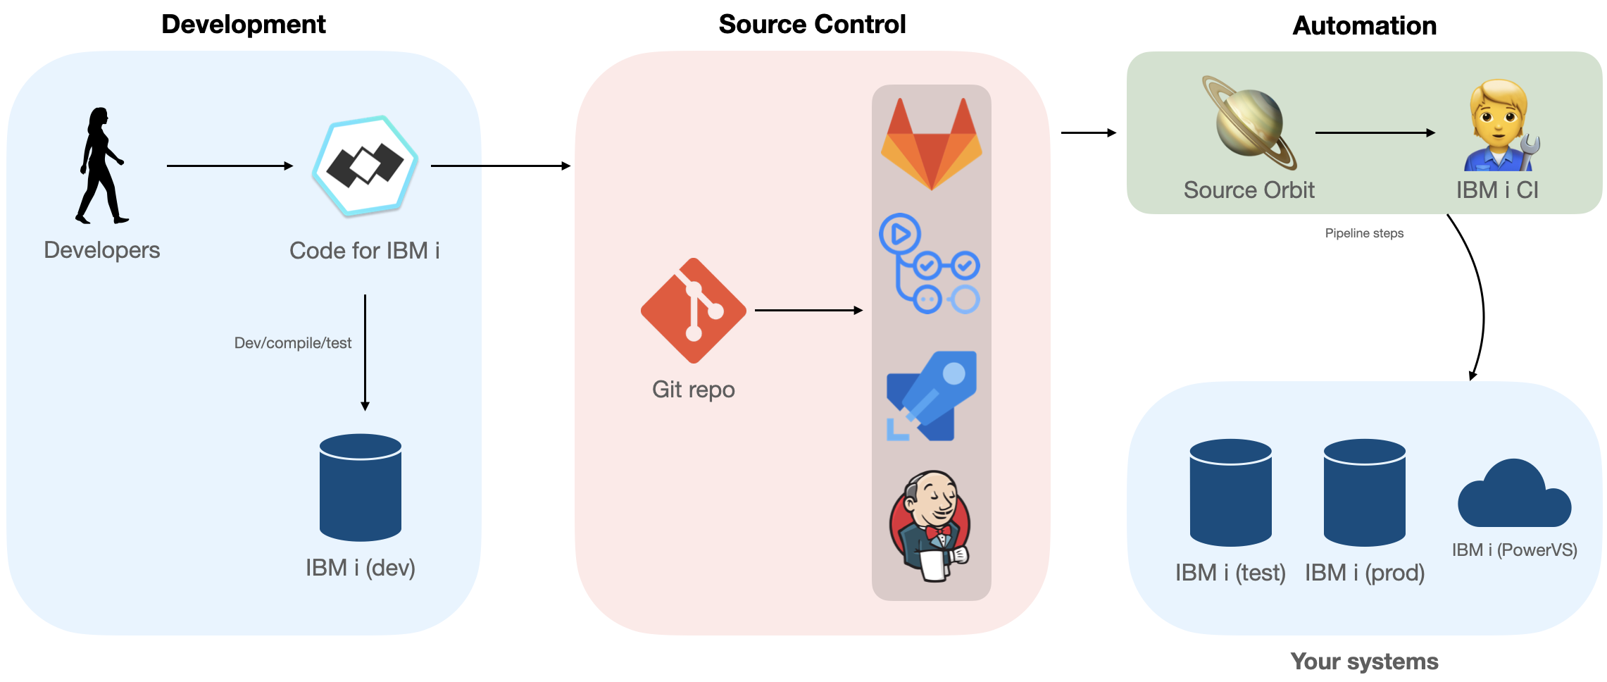
A modern workflow for IBMi developer.
Programmers.io Confidential and Proprietary

Slide 12
References
Jenkins
Getting started with Jenkins.
Create Jenkins pipeline
Setup Jenkins on IBMi
GitBucket
A VCS that can be hosted within IBMi. Click here to learn more.
Source Orbit ()
Defintion of Source Orbit - a dependency management system
A blog post by Liam Barry that tells about the SO - SourceOrbit.
IBMi - CI
A built in CI tool within IBMi. See it in action here
Learn more about IBMi-CI
GIT
A Crash Course YouTube video about GIT
Programmers.io Confidential and Proprietary

Slide 13
Thank you!

